Slide 1
Dan’s Cool Beans

Slide 2
Overview

Slide 3
Major Design Decisions
Baristas and Cashiers are the same thing
At Dan’s Cool Beans, you’re hired as a team member and may be trained in Cashier and Barista positions. Because Cashiers and Baristas have the same permissions and requirements, we decided to keep them in one user type. At each station, they would have their own views pulled up, but we want all employees to be able to fill any role.
Unified menu items and drink items under one model instead of separating them
When we initially designed the class diagrams, we had separated menu items from drink items. The idea was that we didn’t want a customer to create a drink in the database and have it show up on the menu, and we didn’t want items from the menu being passed around.
We learned a lot during this project and discovered later that we could use the same model for both, and instead of editing the selected menu item, it would create a new one instead with additional classifying variables so we would know that it was a user’s drink. We also added a status variable to track and move it through the system. Originally we thought that managing and checking the status of each drink would be more difficult, but Django made it really easy.

Slide 4
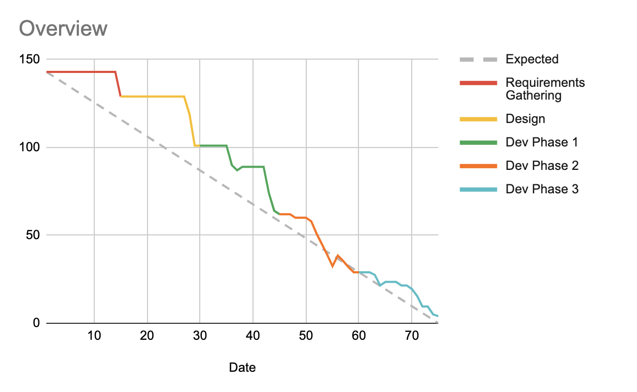
Using Agile
As a group, we followed Agile practices by meeting often, operating in 2 week sprints, and allowed team members to own their tasks while still offering collaboration. We used a Kanban board in Jira to track our tasks, log time, and manage story points.
Our team got a lot better at using Jira over time. The burndown chart learning curve was tricky, but once we learned how it worked, we got better at staying on top of our tasks and updates. Our burndown chart is almost a better example at our improved skill in following Agile than the amount of work that we completed.
We also improved at breaking down tasks into smaller chunks so they were easier to move through the workflow.
Velocity: Completed ~2.17 story points/day

Slide 5
Why we’re ready to deploy
We have created a full fledged POS system for a small coffee shop to run off of.
(Aside from banking and ingredient shipments of course)
The Code
In developing, we were always focused on creating methods that would be reused or easily extended
We reviewed each other’s code every step of the way. Nothing made it to the Main branch without approval from another team member
Testing
We tested each PR before merging to main to protect approved code and ensure quality work.
We also performed a large round of global testing once development was completed.

Slide 6
Tracking Requirements

Slide 7

Customer Creating an Order
List of Requirements we wanted:
View Menu
Select a Predefined drink
Customize the drink
Submit the Order
Money Transaction
Cashier Receives notification
Notes:
Online order (From Requirements)
View menu
Select Drink
Customize ingredients/add-ons (optional)
Increment/decrement ingredients
Submit order
Money leaves account
Goes to manager
Go to Cashier
Give cashier username to look up the order
Wait for drink to be made

Slide 8
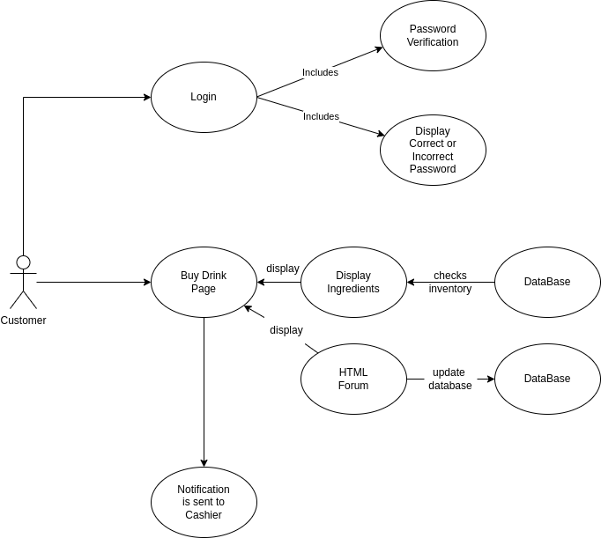
UML, High Level Design
How do we Express our Requiremenets into a design we can implement?
UMLs have helped tremendously when we started the coding process.
Easier keep track of additional changes incurred throught the development course.
Notes:
1. Before we added any functionality, we had to make sure the user was logged in and authenticated before they made any orders.
2. We would then display a page that the customers could see a list of drinks to buy.
When the user clicked on a drink, they were naviaged to a customize drink page.
This page contained a list of ingredients that the drink contained, where the user could manipulate those values via the html Forum
After the order is submitted, the order is send to the cashier.

Slide 9
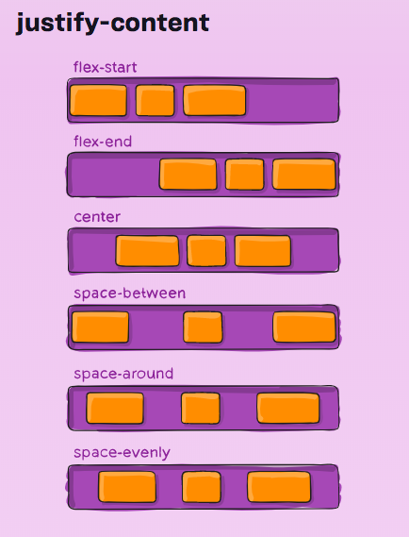
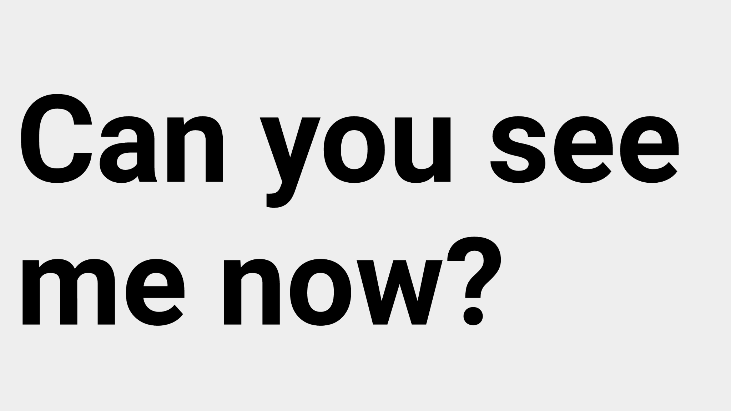
Design Choices
Flex-Box
If you’re using grid, STOP!
Readable Text
Some screens might be bigger than others and the text can be hard to read
Notes:
Flex box is an easy to implement css class that is relatively new.
It helps by automatically centering your elements in either a column or a row.
Flex box can also automatically manage space between other elements in af flex container.
It’s saved me a lot of time and stress
Readable Text:
Some screens might be higher pixel density than others like mobile devices or high pixel density screens
A website can cause frustration if the text is too small and individuals without perfect sight might struggle to use it.
I’ve found that overriding the default font size has increased readability.

Slide 10
Manager Buys Inventory
This functionality was for the manager to buy more inventory so that the customer can always buy from the menu. To allow the manager to buy inventory, the manager first must sign into the website. After, the manager will select on the manage inventory where the manager will have the functionality to buy more ingredients that will be used for the drinks made. It was important because the manager needed to have the functionality to modify the existing items/ingredients in the database that the customer will buy from.

Slide 11
Manager Buys Inventory Implementation
The implementation of the menu item is as follow: A menu item (drink item) is inherited from a ingredient item.
The Manager has access to the ingredient list (which is saved in our population file that populates our database)
A drink item is composed of multiple ingredient items that are tied to the .py file that calculates the cost for each drink item

Slide 12
Manager Updates Menu
This requirement was for the manager (and no one else) to have the ability to add new drinks, or edit or delete existing drinks from the menu at any time. It was important that these changes were reflected in the price of the drink, in the inventory items, to be available when the customers ordered or a cashier made an order, and for all of this to be reflected in the database. It was a must requirement, an important request from the customer of the web app (Dan) and important to the use of the site, though does not directly affect the customers using the site to buy drinks from Dan’s Cool Beans, besides that the menu would be forever unchanging, which isn’t very exciting.

Slide 13
Related tasks
We developed and completed this requirement during all of the sprints of development.
Emily implemented the actual add, edit, and delete of menu items.
Maris later added functionality for adjusting amounts of items near the end of sprint 3 which was then incorporated into the existing code.
Karl helped a lot with styling the table and the buttons so that the page was adaptable and beautiful.
Andre also helped with the back-end side as menu items were composed of the inventory items and understanding the django relationships.

Slide 14
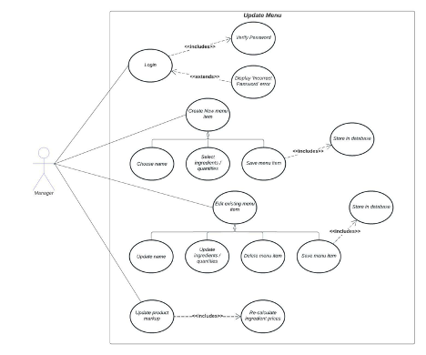
Situation 8: Manager updates Menu
Documentation of this task: UML

Slide 15
Resources
CRUD in Django: https://www.youtube.com/watch?v=FOdtZY5Cv88
Many-to-many Django https://docs.djangoproject.com/en/4.1/topics/db/examples/many_to_many/
May-to-one Django https://docs.djangoproject.com/en/4.1/topics/db/examples/many_to_one/
Django authentication/authorization https://www.youtube.com/watch?v=tUqUdu0Sjyc&t=991s
Understanding through models https://www.revsys.com/tidbits/tips-using-djangos-manytomanyfield/

Slide 16
Questions?

